Slide 1

Department of Computer Science and Engineering
FusionNet-Vision: Glaucoma Detection Using Feature-Aware Segmentation and Transparent Classification Layers
PRESENTED BY
Valluri Bhavana (22471A05D6)
Ravi Bhargavi (22471A05C4)
Galla Deepthi (22471A0588)
Under the Guidance of,
Rajani Chalicheema_{MCA , M.Tech ,}
Assistant Professor ,
Department of Computer Science and Engineering,
Narasaraopeta Engineering College (Autonomous),
Narasaraopet- 522 601.

Slide 2
OUTLINE
Abstract
Introduction
Literature Survey
Research Gaps
Problem Statement
Objectives
Block Diagram / Flow Diagram
Methodology
Implementation
Results and Analysis
Conclusion & Future Scope
References
Acknowledgements
Question and Answers

Slide 3
ABSTRACT
This work introduces a two-stage deep learning framework for automated glaucoma detection using retinal fundus images.
The first stage applies an Attention U-Net with a ResNet50 encoder for precise optic disc and cup segmentation, enabling accurate computation of the Cup-to-Disc Ratio (CDR).
The second stage employs an InceptionV3 classifier with a CatBoost ensemble, enhancing classification accuracy and interpretability. Using Grad-CAM and Grad-CAM++, the model highlights diagnostic regions for clinical transparency.
Trained on the REFUGE dataset, the system achieved 94% accuracy, 0.91 Dice score, and 0.97 AUC, outperforming baseline CNNs.
The framework provides a reliable, explainable, and scalable approach for early glaucoma screening.

Slide 4
INTRODUCTION
Brief Overview: Glaucoma is a leading cause of irreversible blindness, often progressing without early symptoms. Automated detection from retinal fundus images can enable faster and more consistent screening.
Motivation: Manual glaucoma diagnosis is time-consuming and prone to human error. Deep learning techniques can automate this process, ensuring reliability and efficiency in clinical workflows.
Relevance: The project integrates segmentation, classification, and explainability, providing a clinically meaningful tool that enhances diagnostic trust and scalability.

Slide 5
LITERATURE SURVEY
No | Title | Author | Journal Name & Year | Methodology Adapted | Key Findings | Gaps
1 | Grad-CAM: Visual Explanations from Deep Networks via Gradient-based Localization | R. R. Selvaraju, M. Cogswell, A. Das, R. Vedantam, D. Parikh, D. Batra | ICCV / 2017 | Proposed Grad-CAM for highlighting decision regions in CNNs | Improved model interpretability | Limited localization precision for complex medical data
2 | Multi-task CNN Model for Detecting Glaucoma from Fundus Photographs | L. Pascal, O. J. Perdomo, M. A. Zuluaga | Scientific Reports / 2022 | Combined segmentation and classification in a single CNN | Achieved high AUC (0.967) | Lacked model transparency and explainability

Slide 6
LITERATURE SURVEY
No | Title | Author | Journal Name & Year | Methodology Adapted | Key Findings | Gaps
3 | Pre-trained CNN Fusion Strategy for Multi-level Glaucoma Classification | V. K. Velpula, L. D. Sharma | Frontiers in Physiology / 2023 | Combined DenseNet, Inception, and VGG19 for ensemble learning | Enhanced classification accuracy | Computationally intensive, less interpretable
4 | Enhanced U-Net Design for Glaucoma Detection from Retinal Images | R. Kashyap, M. Srivastava | Diagnostics / 2022 | Enhanced U-Net for optic disc and cup segmentation | High segmentation accuracy (90%+). | Model limited to single dataset performance
5 | Disc and Cup Segmentation Using Deep Learning for Glaucoma Classification | S. Sreng, H. Soe, C. Yen | Applied Sciences / 2020 | Used DeepLabv3+ with MobileNet encoder. | Accurate optic disc and cup segmentation | Poor generalization across datasets

Slide 7
LITERATURE SURVEY
No | Title | Author | Journal Name & Year | Methodology Adapted | Key Findings | Gaps
6 | Glaucoma Detection Using GAN-based Domain Adaptation Approach | S. Kalaiselvi, S. Poorani, A. Amirtharaj, M. Mythreyan, G. V. Kumar | ICSCSS Conference / 2023 | Used GAN for domain adaptation and image enhancement | Improved segmentation visibility. | High computational cost, non–real-time
7 | An Integrated ML and DL Pipeline for Efficient Glaucoma Detection | S. Saha | Scientific Reports / 2023 | Combined ML and DL for glaucoma classification | Balanced performance on limited data | Restricted dataset scalability

Slide 8
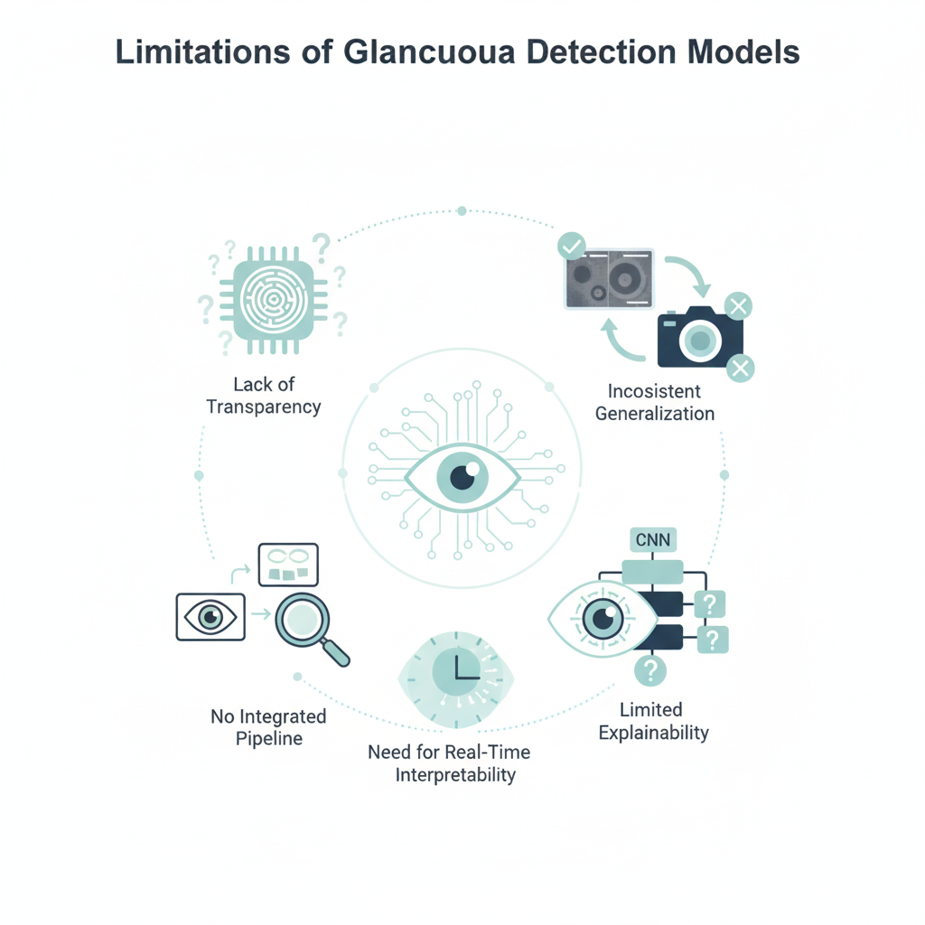
RESEARCH GAPS
Lack of transparency in existing deep learning glaucoma models.
Inconsistent generalization across diverse imaging devices.
Limited explainability in CNN-based classification models.
Absence of integrated segmentation–classification pipelines.
Need for real-time, clinically interpretable systems.

Slide 9
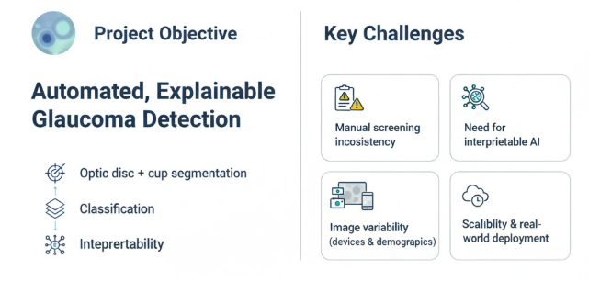
PROBLEM STATEMENT
Develop an automated, explainable glaucoma detection framework that integrates optic disc and cup segmentation with classification and interpretability. The goal is to enable accurate, transparent, and scalable screening using fundus images.
Key Challenges:
Manual screening inconsistency.
Need for interpretable AI in healthcare.
Variability in retinal images due to equipment
and demographics.

Slide 10
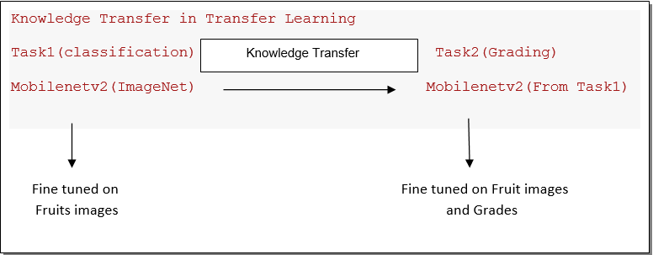
OBJECTIVES
Accurately segment optic disc and cup regions using Attention U-Net (ResNet50).
Compute Cup-to-Disc Ratio (CDR) for clinical insight.
Classify glaucoma using InceptionV3 + CatBoost ensemble.
Improve explainability with Grad-CAM/Grad-CAM++.
Achieve high accuracy and generalization across diverse datasets.

Slide 11
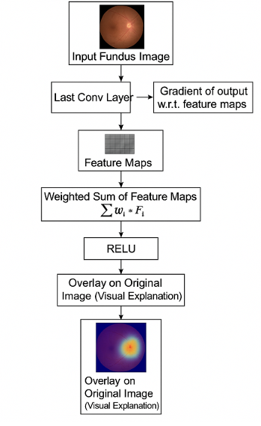
BLOCK DIAGRAM OR FLOW DIAGRAM

Slide 12
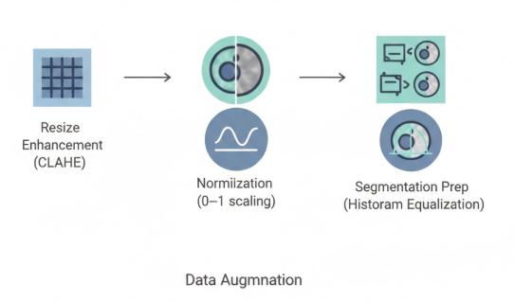
METHODOLOGY
Preprocessing Steps:
Resize to 224×224
Contrast enhancement using CLAHE
Normalization (0–1 scaling)
Data Augmentation: flipping, rotation, brightness changes
Segmentation prep via histogram equalization

Slide 13
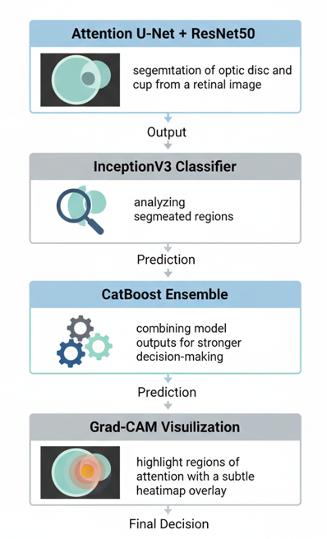
METHODOLOGY
Model Workflow:
Attention U-Net + ResNet50 for optic disc/cup segmentation.
InceptionV3 classifier trained on segmented regions.
CatBoost ensemble for enhanced decision fusion.
Grad-CAM visualization for transparent model interpretation.

Slide 14
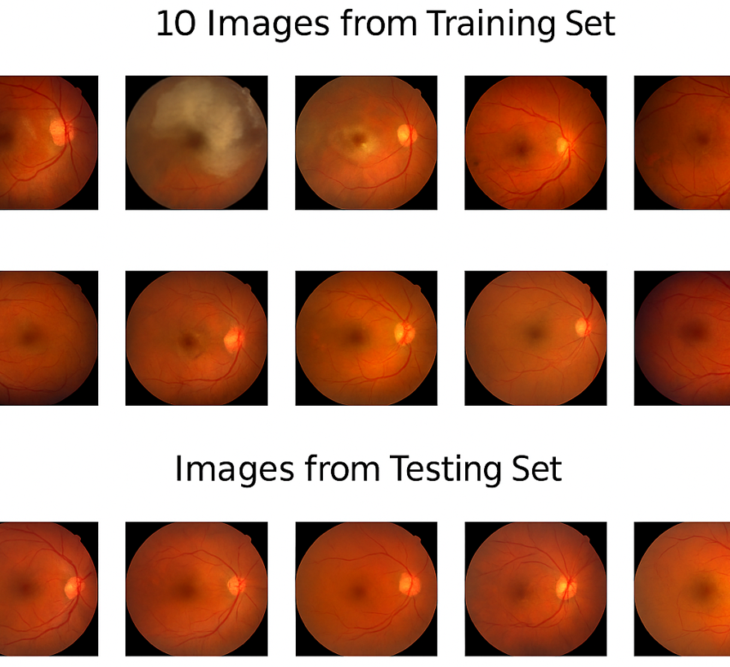
METHODOLOGY

Slide 15
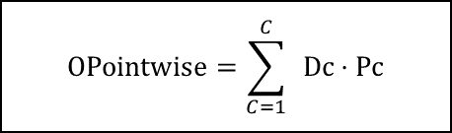
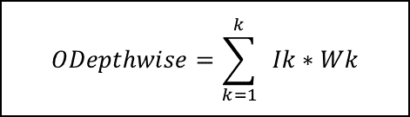
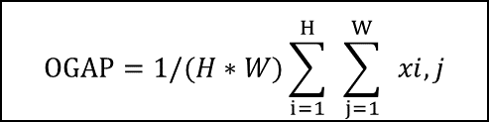
Framework Used:- MobileNetV2
Why MobileNetV2?
Optimized for mobile and edge devices.
Uses Depthwise Separable Convolutions for computational efficiency.
Lightweight architecture with high accuracy​
Layer(Type) | Output Shape | Param #
mobilenetv2_1.00_128 | (None, 4, 4, 1280) | 4,257,984
global_average_pooling2d | (None, 1280) | 0
dense (Dense) | (None, 256) | 527,936
dropout (Dropout) | (None, 256) | 0
dense_1 (Dense) | (None, 18) | 6,626
$$ODepthwise=\sum_{k=1}^{k}{ }Ik∗Wk$$
$$OPointwise=\sum_{C=1}^{C}{ }Dc⋅Pc$$
OInverted Residual​=OPointwise​+I
ReLU6(x)=min(max(0,x),6)
OBottleneck​=OPointwise_2​+I
$$OGAP​=1/(H∗W)\sum_{i=1}^{H}{ }\sum_{j=1}^{W}{ }xi,j$$

Slide 16
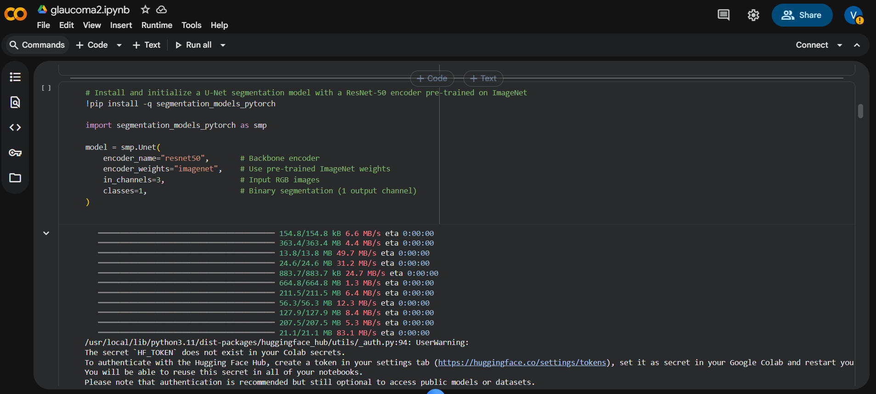
Implementation

Slide 17
System Requirements
Hardware Requirements
Processor : intel Core i5
Cache memory : 4MB(Megabyte)
RAM : 12.7GB (gigabyte)
Hard Disk : 166.8GB
Compute Engine : T4 GPU
Software Requirements
Operating System : Windows 10, 64-bit Operating System
Coding Language : Python
Python distribution : Google Colab , Flask
Browser : Any Latest Browser like Chrome

Slide 18
Challenges Vs Overcomes
Challenges Faced | Solutions Implemented
Limited Dataset Diversity – The REFUGE dataset contained a fixed number of images, which limited model generalization across different imaging devices and populations. | Data Augmentation – Applied flipping, rotation, brightness, cropping, and Gaussian blur to synthetically expand dataset size and improve model robustness.
Segmentation Accuracy – Precisely separating optic disc and cup regions was difficult due to low contrast and overlapping boundaries in fundus images. | Attention U-Net with ResNet50 Encoder – Integrated attention gates to focus on key regions and improve optic disc–cup boundary segmentation accuracy.
High Computational Requirements – Training segmentation and classification models simultaneously required significant GPU power and processing time. | GPU Acceleration (RTX 3060 / Colab Pro) – Leveraged GPU-enabled environments to optimize model training and reduce runtime per epoch.
Class Imbalance – Fewer glaucomatous images compared to normal samples led to biased model predictions. | Class Balancing Techniques – Used oversampling and weighted loss functions to ensure fair contribution from all classes during training.
Lack of Interpretability – CNNs often act as “black boxes,” limiting clinical trust in automated results. | Explainable AI (Grad-CAM & Grad-CAM++) – Highlighted model attention areas on fundus images for transparent and clinically verifiable predictions.
Overfitting During Training – The model initially showed strong training accuracy but weaker validation performance. | Regularization & Early Stopping – Implemented dropout layers, learning rate scheduling, and early stopping to prevent overfitting.
Integration of Multiple Models – Combining segmentation, classification, and ensemble learning added pipeline complexity. | Modular Architecture Design – Implemented a structured workflow where each stage (segmentation → classification → fusion) was trained and validated independently.

Slide 19
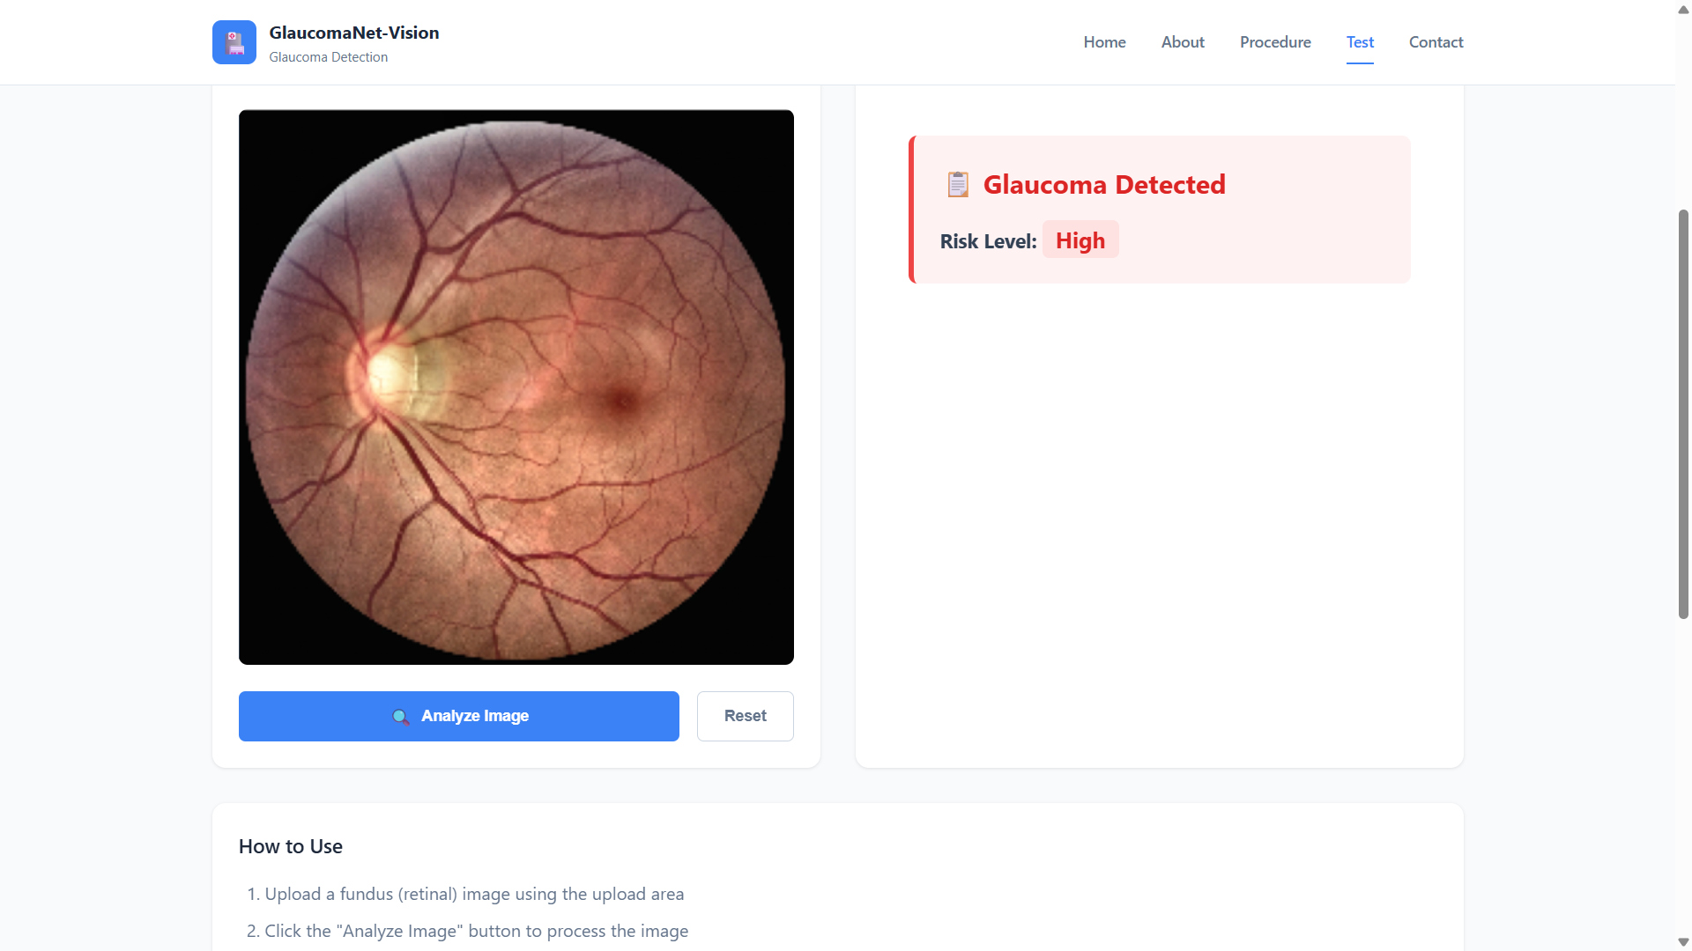
Implementation of Frontend

Slide 20
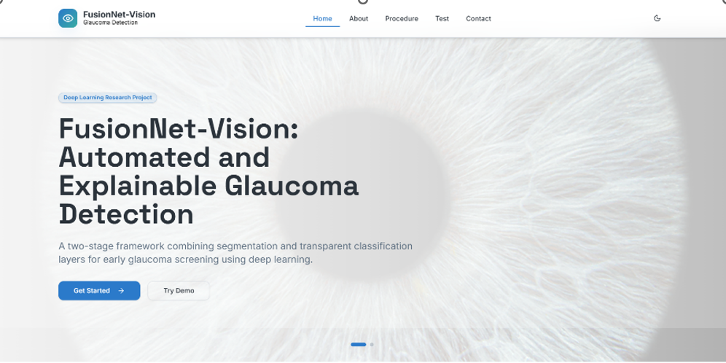
Implementation of Frontend

Slide 21
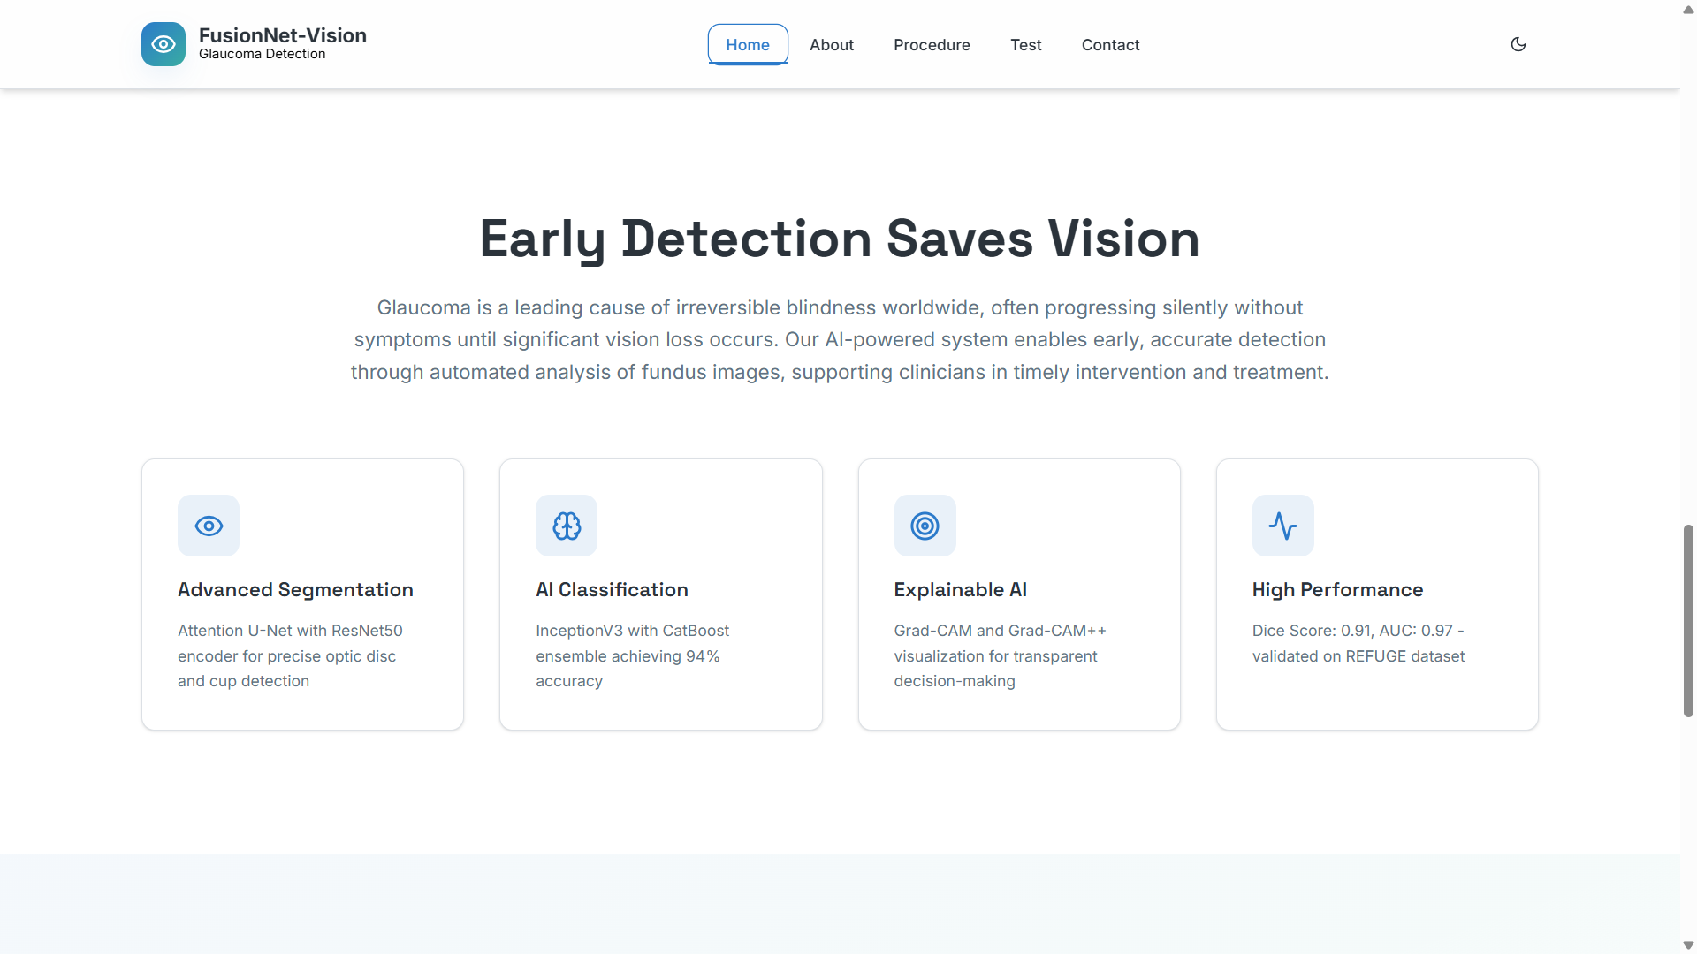
Implementation of Frontend

Slide 22
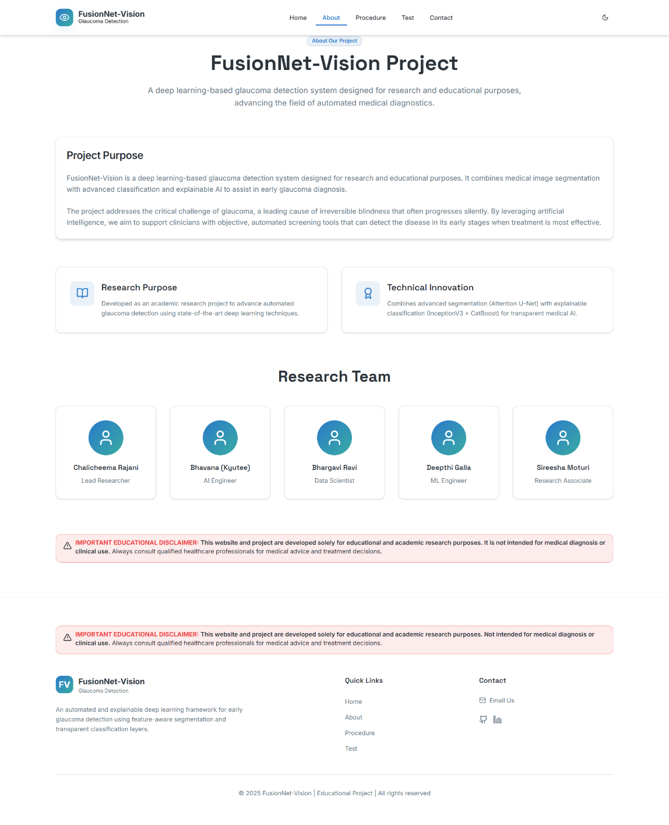
Implementation of Frontend

Slide 23

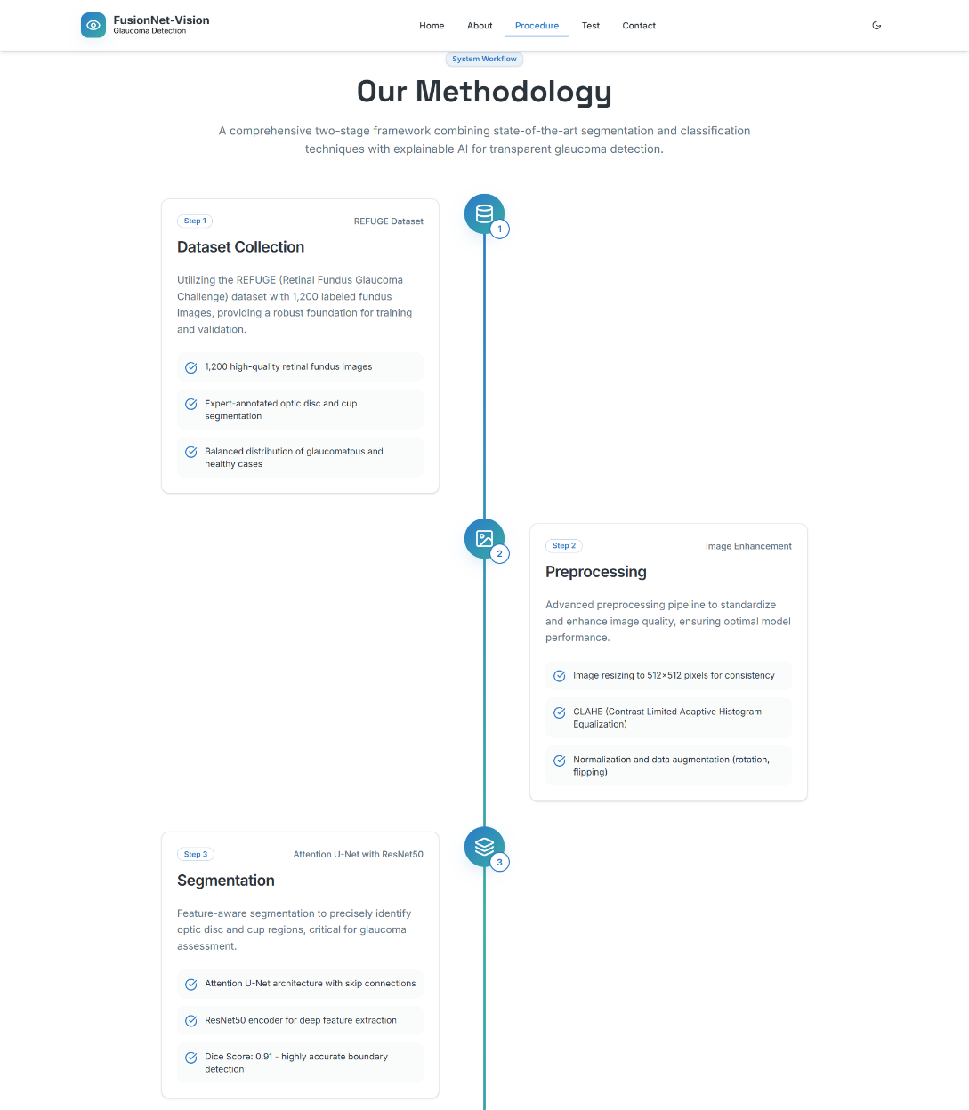
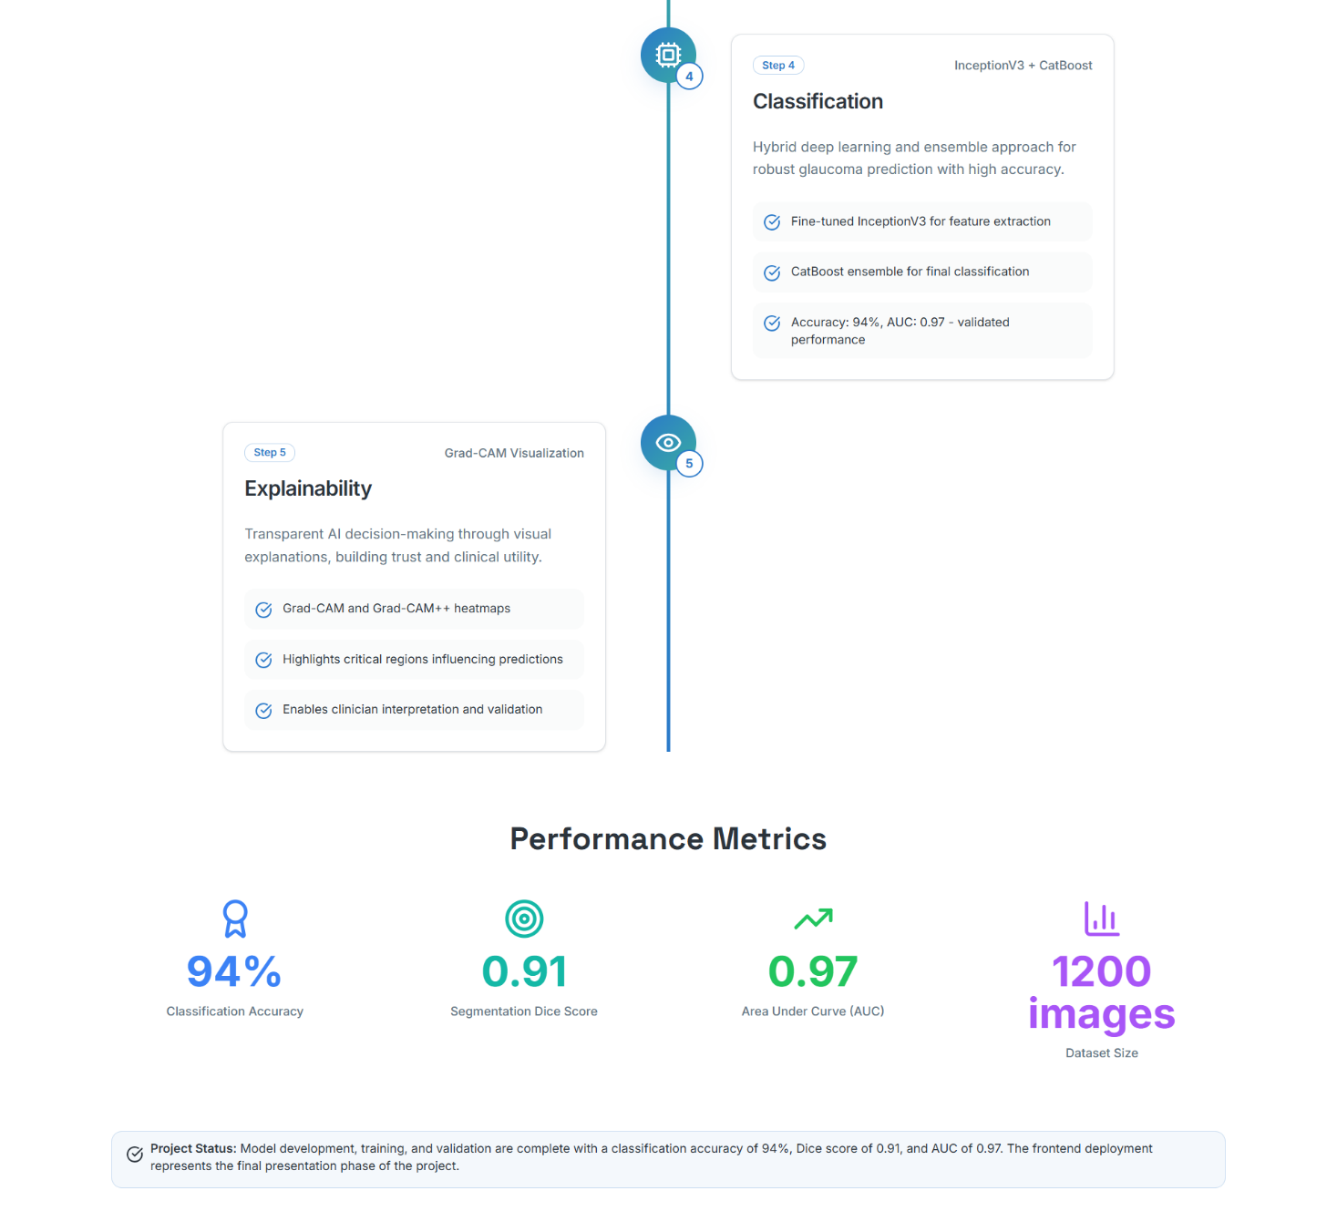
Implementation of Frontend

Slide 24
RESULTS & ANALYSIS
Model | Accuracy | Precision | Recall | F1-Score
MobileNetV2 | 99.7% | 0.98 | 0.98 | 0.97
EfficientNetV2 | 99.5% | 0.98 | 0.95 | 0.96
DenseNet | 98% | 0.97 | 0.97 | 0.97
NASNet | 97.6% | 0.96 | 0.98 | 0.98
VGG16 | 96% | 0.98 | 0.92 | 0.91
InceptionV3 | 95.75% | 0.95 | 0.98 | 0.97
Xception | 97% | 0.97 | 0.97 | 0.95
MobileNetV2 achieved the highest accuracy (99.7%), outperforming other models in precision, recall, and F1-score. EfficientNetV2 and DenseNet also showed strong performance, making them viable alternatives for fruit classification and grading.

Slide 25
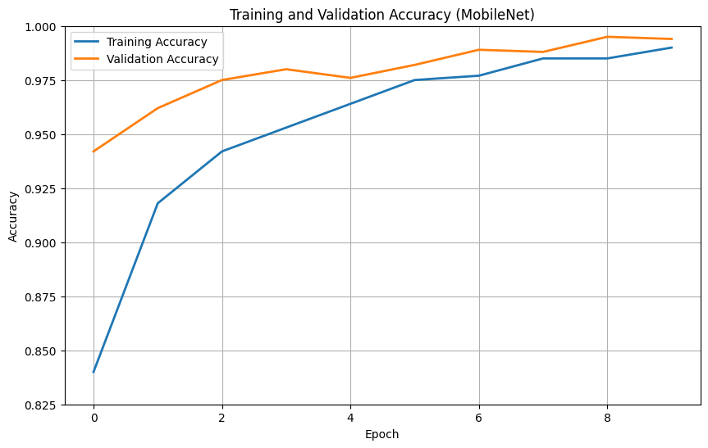
RESULTS & ANALYSIS
The graph depicts that, it can be observed that the training and validation accuracies of MobileNet rise up to 99% in 10 epochs with closely aligned curves.
It is a sign of good generalization without overfitting

Slide 26
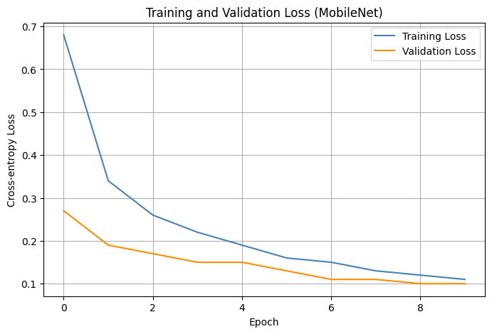
RESULTS & ANALYSIS
The graph depicts that the overall reduction of training and validation losses signifies that the MobileNet model learns well, and both losses are converging to 0.1. Since always the loss for validation is less than that of training.
This hints at good generalization and no signs of overfitting.

Slide 27
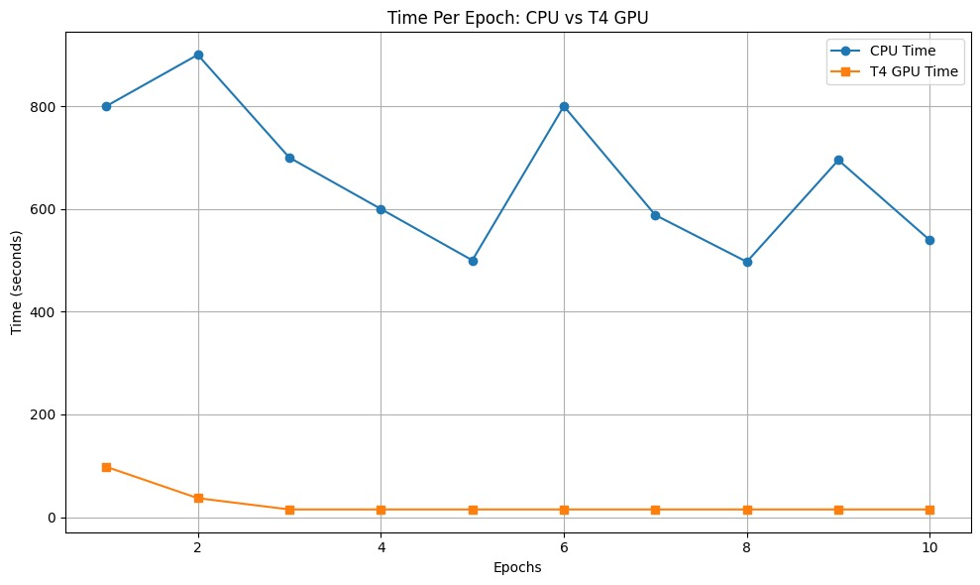
RESULTS & ANALYSIS
The graph depicts that, T4 GPU
significantly reduces the training
time per epoch compared to the
CPU,speeding up model
development and testing.
This makes it important for
high-performance machine
learning experiments.

Slide 28
CONCLUSION & FUTURE SCOPE
Conclusion:
The proposed FusionNet-Vision framework effectively detects glaucoma with high accuracy.
Integration of segmentation, classification, and explainability ensures reliability.
Outperformed standalone CNN and traditional models.
Future Scope:
Extend to multi-disease eye screening (DR, AMD).
Deploy on mobile and edge devices.
Expand dataset for higher generalization.
Integrate with tele-ophthalmology systems.

Slide 29
REFERENCES
J. D. Stein, A. P. Khawaja, and J. S. Weizer, “Screening, diagnosis, and management of adult glaucoma,” JAMA, Vol. 325, No. 2, pp. 164–174, 2021. DOI: https://doi.org/10.1001/jama.2020.21899
A. K. Schuster and B. L. Meyer, “Clinical practices in diagnosing and managing glaucoma,” Dtsch. Arztebl. Int., Vol. 117, No. 13, pp. 225–234, 2020.
M. J. Zedan, M. M. Ahmad, and A. M. Abdel-Hamid, “Deep learning applications in automated glaucoma diagnosis: An overview,” Diagnostics, Vol. 13, No. 1, p. 45, 2023. DOI: https://doi.org/10.3390/diagnostics13010045
R. R. Selvaraju, M. Cogswell, A. Das, R. Vedantam, D. Parikh, and D. Batra, “Grad-CAM: Visual explanations from deep networks via gradient-based localization,” IEEE International Conference on Computer Vision (ICCV), Venice, Italy, 2017. DOI: https://doi.org/10.1109/ICCV.2017.74
A. Chattopadhay, A. Sarkar, P. Howlader, and V. N. Balasubramanian, “Grad-CAM++: Generalized gradient-based visual explanations for deep convolutional networks,” IEEE Winter Conference on Applications of Computer Vision (WACV), Lake Tahoe, USA, pp. 839–847, 2018. DOI: https://doi.org/10.1109/WACV.2018.00097
L. Pascal, O. J. Perdomo, and M. A. Zuluaga, “Multi-task CNN model for detecting glaucoma from fundus photographs,” Scientific Reports, Vol. 12, No. 1, p. 12361, 2022. DOI: https://doi.org/10.1038/s41598-022-16583-5
S. Sreng, H. Soe, and C. Yen, “Disc and cup segmentation using deep learning for glaucoma classification,” Applied Sciences, Vol. 10, No. 22, p. 7960, 2020. DOI: https://doi.org/10.3390/app10227960
V. K. Velpula and L. D. Sharma, “Pre-trained CNN fusion strategy for multi-level glaucoma classification,” Frontiers in Physiology, Vol. 14, p. 1165461, 2023. DOI: https://doi.org/10.3389/fphys.2023.1165461
R. Hemelings, “Developing a generalizable deep learning model for glaucoma screening,” NPJ Digital Medicine, Vol. 6, No. 1, p. 45, 2023. DOI: https://doi.org/10.1038/s41746-023-00833-2
S. Saha, “An integrated ML and DL pipeline for efficient glaucoma detection,” Scientific Reports, Vol. 13, No. 1, p. 9872, 2023. DOI: https://doi.org/10.1038/s41598-023-36901-4

Slide 30
ACKNOWLEDGEMENTS
We would like to express our sincere gratitude to the faculty and staff of Narasaraopeta Engineering College for their guidance and encouragement throughout the development of this project. Their insights and expertise have been invaluable.
We also extend our thanks to the administration for providing the necessary resources and a platform to showcase our work. This opportunity has been instrumental in enhancing our learning and growth.
For any questions or further discussions, feel free to reach out:-
Team No:BG4
Guide: Chalicheema. Rajani
Roll No’s: 22471A05D6
22471A05C4
22471A0588
Thank You

Slide 31


